Slide 1

Context Areas, Zoning Districts, Uses, and Building Types

Slide 2
Roadmap
What are the Context Areas we’re proposing?
How might they inform new Zoning Districts?
How will Uses be updated?
Introducing Building Types, and how they relate to proposed Context Areas and Zoning Districts?
Let’s run through the key updates since we last met

Slide 3
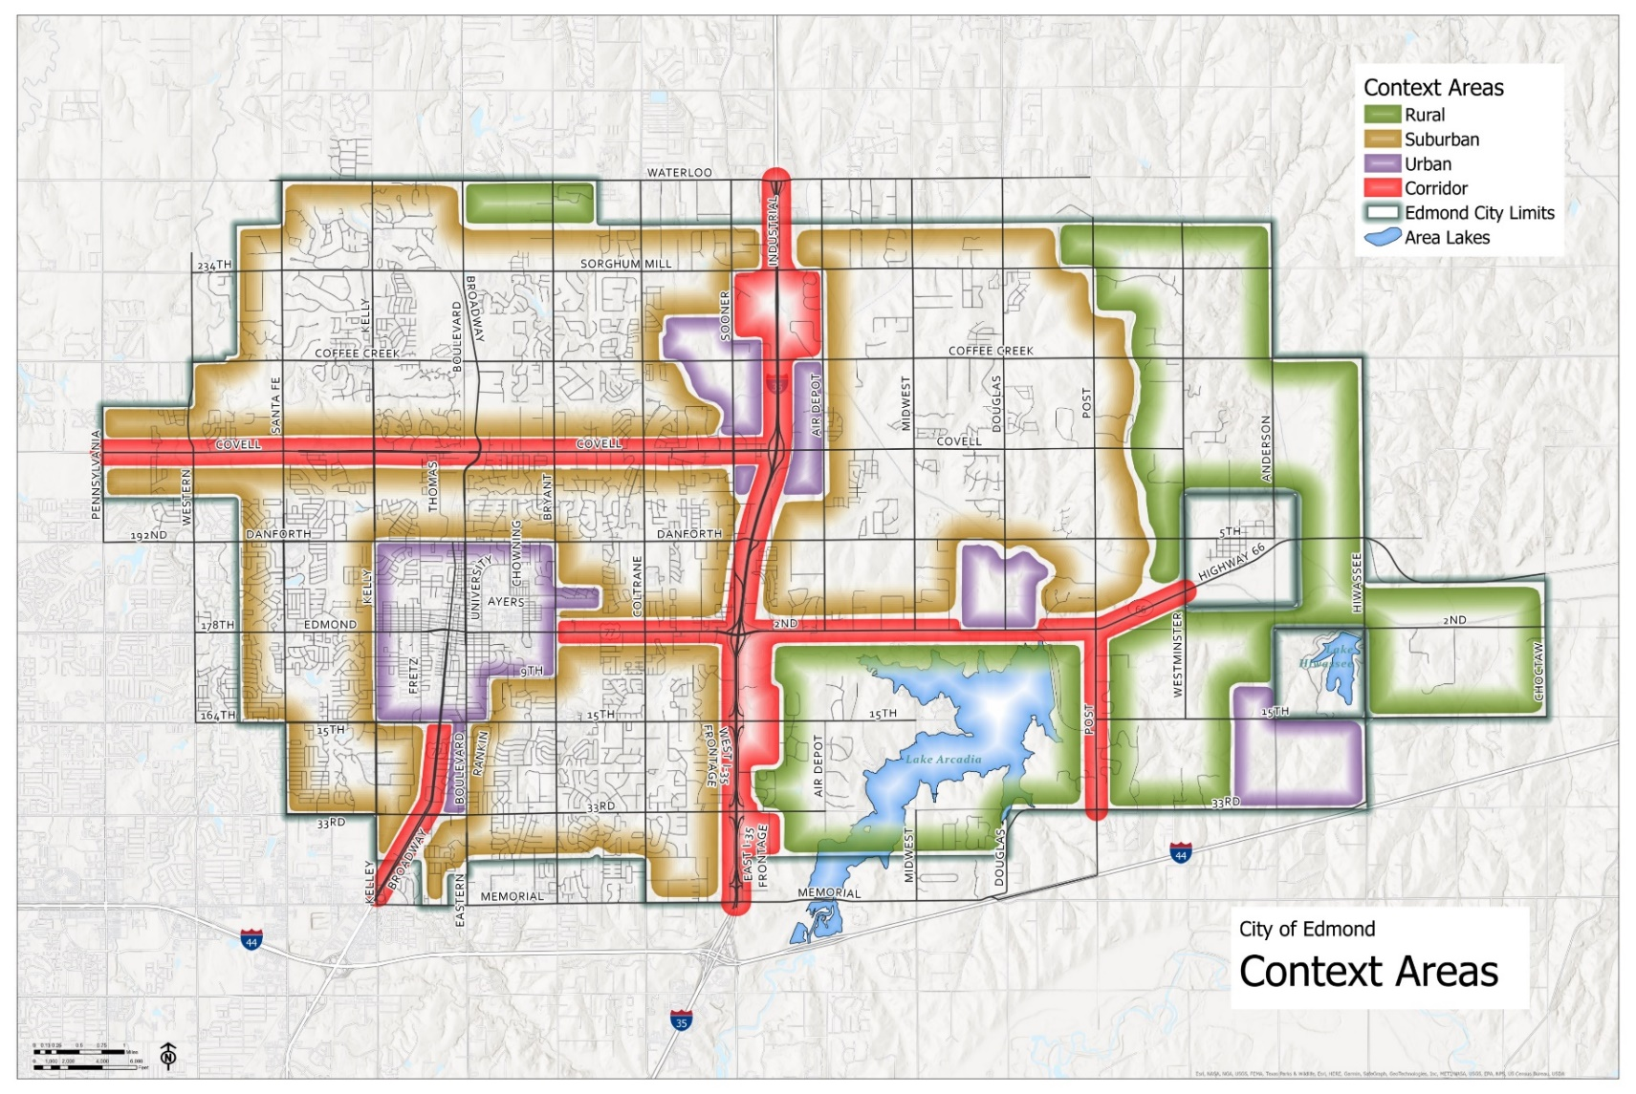
Context Areas: Overview

Slide 4
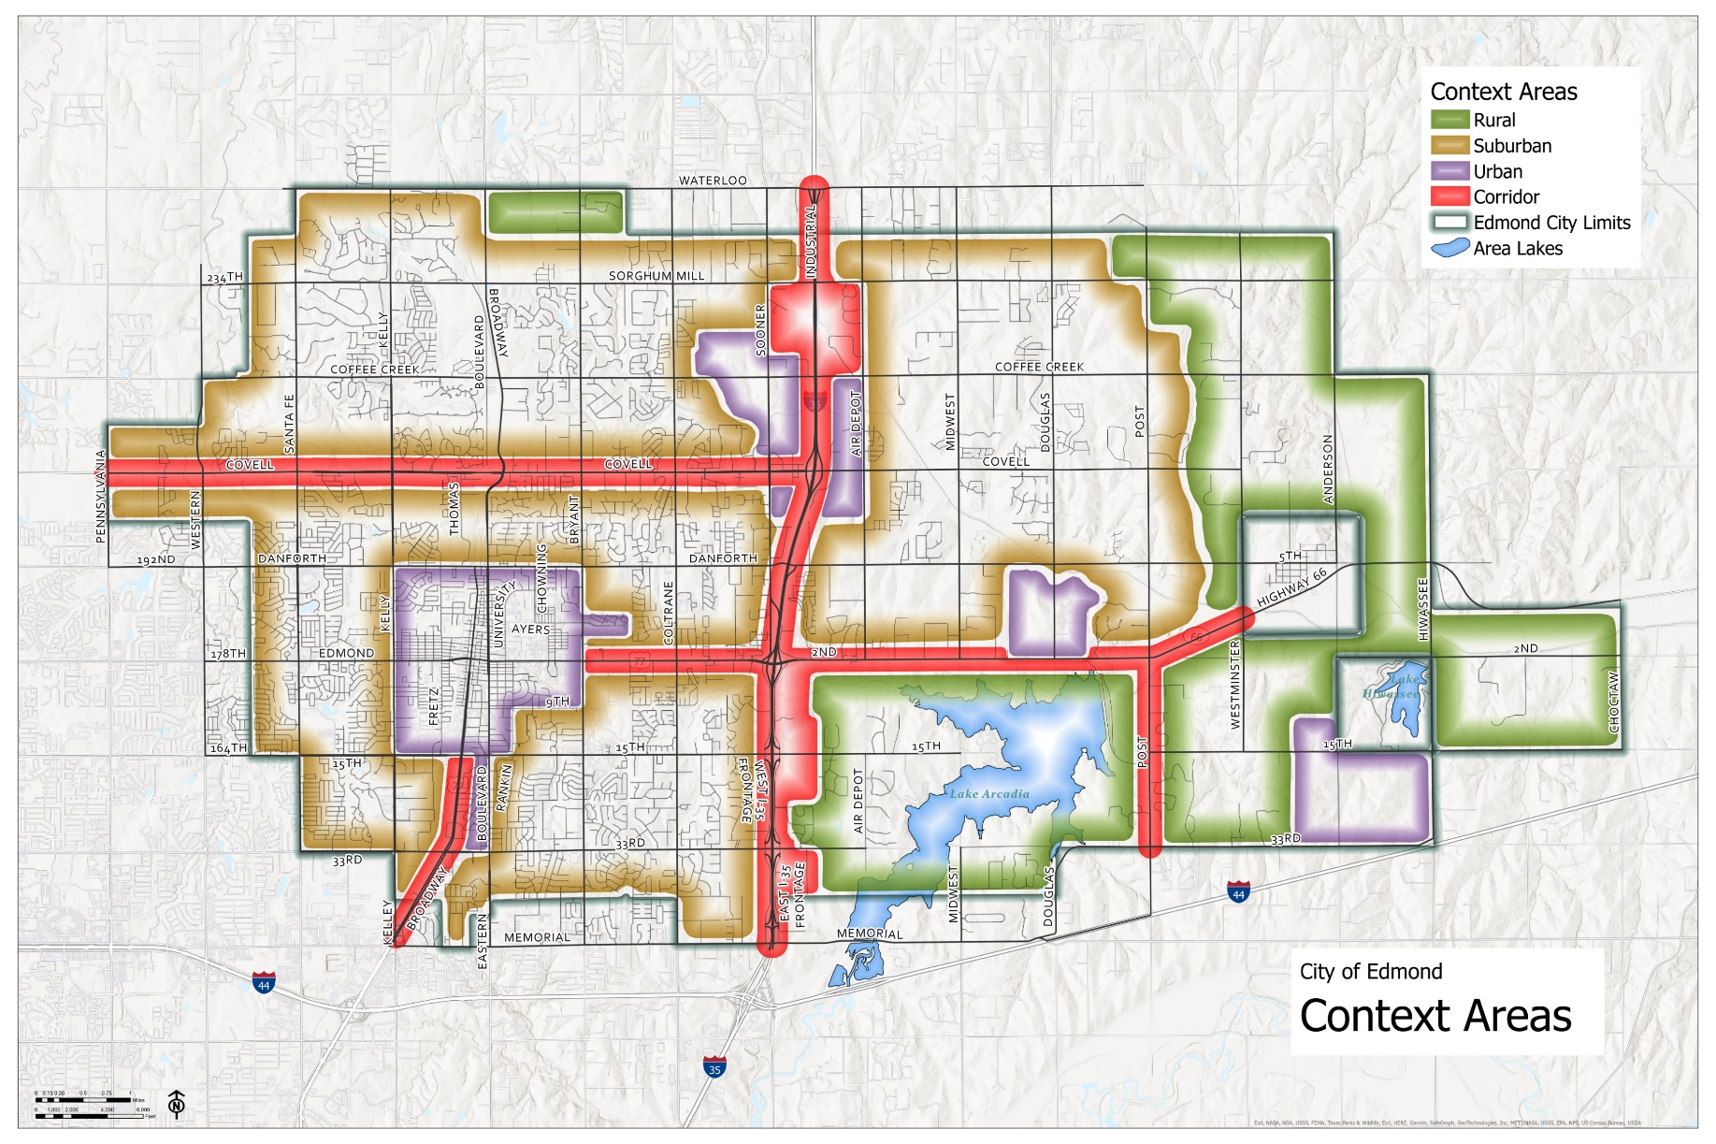
Context Areas: Rural
      Outside of Edmond’s core
      In the outer regions of the corporate limits
      Limited infrastructure
      Where large lots are undeveloped, reserved for agricultural uses, preserved for the Cross Timbers Forest, or single family residences
      Identified as Open Space, Agricultural, or Rural Neighborhood on the Edmond Plan Category Map, as amended

Slide 5
Context Areas: Suburban
      Outside of Edmond’s core
      Not within the outer regions of the City’s corporate limits
      Infrastructure and utilities exist or are imminent
      Built-out with existing development
      Identified as Suburban 1 Neighborhood, Suburban 2 Neighborhood, Suburban Infill, Suburban Commercial, Destination Retail, or Employment, on the Edmond Plan Category Map, as amended

Slide 6
Context Areas: Urban/Compact
      Built-out with existing development
      Primed for redevelopment
      Dense and walkable development patterns
      Identified as Downtown Core, Urban Neighborhood, University Neighborhood, Village Low, Village Moderate, Town Square, Urban Center, Mixed Use Campus, Employment, Destination Retail, or Civic or Institution on the Edmond Plan Category Map, as amended

Slide 7
Context Areas: Corridor
      Located along the City’s most significant thoroughfares with high traffic volumes, typically serving as gateways to the City
      Identified as Broadway Corridor, I-35, or Transit District on the Edmond Plan Category Map, as amended

Slide 8
Context Areas: Overview
Notes:
So, zooming back out to the broader layout of the City’s Context Areas, we can start to discuss the implications these may have for other land use regulations such as Zoning

Slide 9
Zoning Districts
New Zoning
Context Area | Zoning District | Nomenclature
Rural | Agricultural Preservation | R-AP
 | Mixed Use | R-MU
Suburban | Residential | S-RE
 | Mixed Use | S-MU
 | Local Commercial | S-LC
 | Regional Commercial | S-RC
 | Flex Industrial | S-FI
Urban | Downtown | U-DT
 | Town Square | U-TS
 | Regional Mixed Use | U-RM
Corridor | U.S. Interstate 35 | C-IS
 | Broadway | C-BW
 | Transit | C-TT
      Multiple ways Context Areas can relate to Zoning Districts
      Varying degrees of regulatory power
What are your thoughts? How should we approach the use of these areas?
Notes:
There are different ways we can structure the Context Areas, and each method is well-suited to different ways of setting up and administering Zoning. Shown here, the approach we initially proposed, is a relationship which makes Context Areas highly regulatory, essentially another layer of Zoning. Each Context Area permits certain Districts, which generally cannot appear in other Context Areas.

Slide 10
Zoning Districts: R-AP
      The Rural – Agricultural Preservation (R-AP) District accommodates the continued use of agricultural lands, and preservation of the Cross Timbers Forest, wildlife, and open space.
Rural – Agricultural Preservation (R-AP) District Dimensional Standards
Lot Requirements
A | Lot Area (min.) | 20 acres
C | Lot Coverage (max.) | 10%
Setback Requirements
D | Front Yard (min.) | 50 feet
E | Rear Yard (min.) | 30 feet
F | Side Yard (min.) | 25 feet
G | Corner Side Yard (min.) | 25 feet
Building Requirements
H | Building Height (max.) | 35 feet
I | Building Footprint (max.) | 10,000 square feet
Additional Applicable Requirements within the UDC
Notes:
There are different ways we can structure the Context Areas, and each method is well-suited to different ways of setting up and administering Zoning. Shown here, the approach we initially proposed, is a relationship which makes Context Areas highly regulatory, essentially another layer of Zoning. Each Context Area permits certain Districts, which generally cannot appear in other Context Areas.

Slide 11
Zoning Districts: R-MU
      The Rural – Mixed Use (R-MU) District is intended to provide for a mixed development pattern where low density, large lot residential development is the predominant development pattern complemented by low intensive nonresidential uses […]
Rural – Mixed Use (R-MU) District Dimensional Standards
Lot Requirements
A | Lot Area (min.) | 5 acres
B | Lot Width (min.) | 100 feet
C | Lot Coverage (max.) | 20%
Setback Requirements
D | Front Yard (min.) | 40 feet
E | Rear Yard (min.) | 20 feet
F | Side Yard (min.) | 15 feet
G | Corner Side Yard (min.) | 15 feet
Building Requirements
H | Building Height (max.) | 35 feet
I | Building Footprint (max.) | 10,000 square feet
Additional Applicable Requirements within the UDC
Notes:
There are different ways we can structure the Context Areas, and each method is well-suited to different ways of setting up and administering Zoning. Shown here, the approach we initially proposed, is a relationship which makes Context Areas highly regulatory, essentially another layer of Zoning. Each Context Area permits certain Districts, which generally cannot appear in other Context Areas.

Slide 12
Zoning Districts: S-RE
      The Suburban – Residential (S-RE) District is intended to provide for a residential development pattern that emphasizes single-family residences with supporting amenities such as parks, open space, and neighborhood services that maintains Edmond's established neighborhood form.
Suburban – Residential (S-RE) District Dimensional Standards
Lot Requirements
A | Lot Area (min.) | 6,000 square feet
B | Lot Width (min.) | 50 feet
C | Lot Coverage (max.) | 45%
Setback Requirements
D | Front Yard (min.) | 25 feet
E | Rear Yard (min.) | 20 feet
F | Side Yard (min.) | 5 feet
G | Corner Side Yard (min.) | 15 feet
Building Requirements
H | Building Height (max.) | 35 feet
Additional Applicable Requirements within the UDC
Notes:
There are different ways we can structure the Context Areas, and each method is well-suited to different ways of setting up and administering Zoning. Shown here, the approach we initially proposed, is a relationship which makes Context Areas highly regulatory, essentially another layer of Zoning. Each Context Area permits certain Districts, which generally cannot appear in other Context Areas.

Slide 13
Zoning Districts: S-MU
      The Suburban – Mixed Use (S-MU) District is intended to provide for a mixed development pattern where a mix of housing types is the predominant development pattern, and the residential components are complemented by appropriately scaled nonresidential uses.
Suburban – Mixed Use (S-MU) District Dimensional Standards
Lot Requirements
A | Lot Area (min.) | 4,500 square feet
B | Lot Width (min.) | 40 feet
C | Lot Coverage (max.) | 50%
Setback Requirements
D | Front Yard (min.) | 20 feet
E | Rear Yard (min.) | 10 feet
F | Side Yard (min.) | 5 feet
G | Corner Side Yard (min.) | 10 feet
Building Requirements
H | Building Height (max.) | 35 feet
Additional Applicable Requirements within the UDC
Notes:
There are different ways we can structure the Context Areas, and each method is well-suited to different ways of setting up and administering Zoning. Shown here, the approach we initially proposed, is a relationship which makes Context Areas highly regulatory, essentially another layer of Zoning. Each Context Area permits certain Districts, which generally cannot appear in other Context Areas.

Slide 14
Zoning Districts: S-LC
      The Suburban – Local Commercial (S-LC) District provides a range of nonresidential uses, such as offices, personal services, and limited retail sales at an intensity that supports nearby residential uses.
Suburban – Local Commercial (S-LC) District Dimensional Standards
Lot Requirements
A | Lot Area (min.) | 5,000 square feet
B | Lot Width (min.) | 50 feet
C | Lot Coverage (max.) | 40%
Setback Requirements
D | Front Yard (min.) | 25 feet
E | Rear Yard (min.) | 5 feet
F | Side Yard (min.) | 0 feet
G | Corner Side Yard (min.) | 15 feet
Building Requirements
H | Building Height (max.) | 35 feet
I | Building Footprint (max.) | 15,000 square feet
Additional Applicable Requirements within the UDC
Notes:
There are different ways we can structure the Context Areas, and each method is well-suited to different ways of setting up and administering Zoning. Shown here, the approach we initially proposed, is a relationship which makes Context Areas highly regulatory, essentially another layer of Zoning. Each Context Area permits certain Districts, which generally cannot appear in other Context Areas.

Slide 15
Zoning Districts: S-RC
      The Suburban – Regional Commercial (S-RC) District provides for shopping and commercial activities along arterials that offer a full range of consumer retail opportunities, employment services, and tourist attractions at a regional scale.
Suburban – Regional Commercial (S-RC) District Dimensional Standards
Lot Requirements
A | Lot Area (min.) | 10,000 square feet
B | Lot Width (min.) | 50 feet
C | Lot Coverage (max.) | 60%
Setback Requirements
D | Front Yard (min.) | 50 feet
E | Rear Yard (min.) | 5 feet
F | Side Yard (min.) | 0 feet
G | Corner Side Yard (min.) | 20 feet
Building Requirements
H | Building Height (max.) | 45 feet
I | Building Footprint (max.) | 200,000 square feet
Additional Applicable Requirements within the UDC
Notes:
There are different ways we can structure the Context Areas, and each method is well-suited to different ways of setting up and administering Zoning. Shown here, the approach we initially proposed, is a relationship which makes Context Areas highly regulatory, essentially another layer of Zoning. Each Context Area permits certain Districts, which generally cannot appear in other Context Areas.

Slide 16
Zoning Districts: S-FI
      The Suburban – Flex Industrial (S-FI) District provides for manufacturing, wholesaling, warehousing, research facilities, and similar type industrial uses and employers that are generally clean, quiet, and free of hazardous materials, and do not produce obvious noise, odor, dust, smoke, or glare.
Suburban – Flex Industrial (S-FI) District Dimensional Standards
Lot Requirements
A | Lot Area (min.) | 10,000 square feet
B | Lot Width (min.) | 50 feet
C | Lot Coverage (max.) | 75%
Setback Requirements
D | Front Yard (min.) | 30 feet
E | Rear Yard (min.) | 10 feet
F | Side Yard (min.) | 5 feet
G | Corner Side Yard (min.) | 20 feet
Building Requirements
H | Building Height (max.) | 45 feet
Additional Applicable Requirements within the UDC
Notes:
There are different ways we can structure the Context Areas, and each method is well-suited to different ways of setting up and administering Zoning. Shown here, the approach we initially proposed, is a relationship which makes Context Areas highly regulatory, essentially another layer of Zoning. Each Context Area permits certain Districts, which generally cannot appear in other Context Areas.

Slide 17
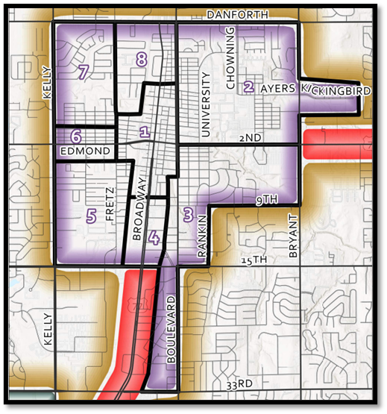
Zoning Districts: U-DT
      The Urban – Downtown (U-DT) District intends to require and allow pedestrian-oriented, mixed-use, urban infill redevelopment, providing shopping, employment, housing, and business and personal services; encourage pedestrian activity while reducing the reliance on automobiles […]
Notes:
There are different ways we can structure the Context Areas, and each method is well-suited to different ways of setting up and administering Zoning. Shown here, the approach we initially proposed, is a relationship which makes Context Areas highly regulatory, essentially another layer of Zoning. Each Context Area permits certain Districts, which generally cannot appear in other Context Areas.

Slide 18
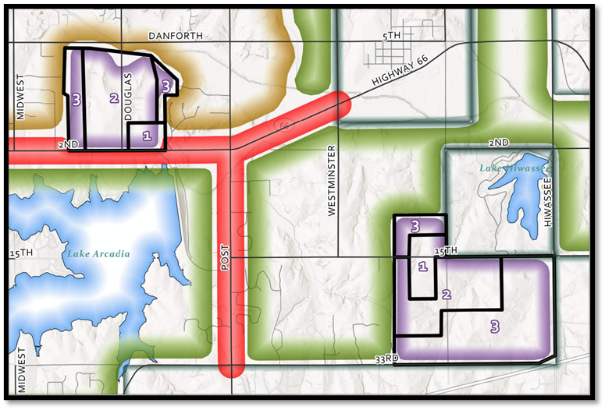
Zoning Districts: U-TS
      The Urban – Town Square (U-TS) District provides for a pedestrian-scaled, harmonious mix of residential and nonresidential uses in a nodal, historic village or town square-like development pattern located outside of Edmond’s downtown area.
Notes:
There are different ways we can structure the Context Areas, and each method is well-suited to different ways of setting up and administering Zoning. Shown here, the approach we initially proposed, is a relationship which makes Context Areas highly regulatory, essentially another layer of Zoning. Each Context Area permits certain Districts, which generally cannot appear in other Context Areas.

Slide 19
Zoning Districts: C-IS
      The Corridor – U.S. Interstate 35 (C-IS) District provides for a moderate to high intensity mixed-use development pattern along Interstate 35 (I-35) frontage where nonresidential activity is the predominant development characteristic.
Corridor – U.S. Interstate 35 (C-IS) District Dimensional Standards
Lot Requirements
A | Lot Area (min.) | 10,000 square feet
B | Lot Width (min.) | 50 feet
C | Lot Coverage (max.) | 50%
Setback Requirements
D | Front Yard (min.) | 50 feet
E | Rear Yard (min.) | 0 feet
F | Side Yard (min.) | 10 feet
G | Corner Side Yard (min.) | 25 feet
Building Requirements
H | Building Height (max.) | 70 feet
Additional Applicable Requirements within the UDC
Notes:
There are different ways we can structure the Context Areas, and each method is well-suited to different ways of setting up and administering Zoning. Shown here, the approach we initially proposed, is a relationship which makes Context Areas highly regulatory, essentially another layer of Zoning. Each Context Area permits certain Districts, which generally cannot appear in other Context Areas.

Slide 20
Zoning Districts: C-BW
      The Corridor – Broadway (C-BW) District provides for nonresidential redevelopment opportunities along one of the City's most significant gateways, the South Broadway Corridor.
Corridor – Broadway (C-BW) District Dimensional Standards
Lot Requirements
A | Lot Area (min.) | 5,000 square feet
B | Lot Width (min.) | 50 feet
C | Lot Coverage (max.) | 50%
Setback Requirements
D | Front Yard (min.) | 50 feet
E | Rear Yard (min.) | 5 feet
F | Side Yard (min.) | 0 feet
G | Corner Side Yard (min.) | 25 feet
Building Requirements
H | Building Height (max.) | 45 feet
Additional Applicable Requirements within the UDC
Notes:
There are different ways we can structure the Context Areas, and each method is well-suited to different ways of setting up and administering Zoning. Shown here, the approach we initially proposed, is a relationship which makes Context Areas highly regulatory, essentially another layer of Zoning. Each Context Area permits certain Districts, which generally cannot appear in other Context Areas.

Slide 21
Zoning Districts: C-TT
      The Corridor – Transit (C-TT) District provides for a mixed- use development pattern stemming from the implementation of a regional rail system.
Corridor – Transit (C-TT) District Dimensional Standards
Lot Requirements
A | Lot Area (min.) | N/A
B | Lot Width (min.) | 40 feet
C | Lot Coverage (max.) | 60%
Setback Requirements
D | Front Yard (min.) | 10 feet
E | Rear Yard (min.) | 5 feet
F | Side Yard (min.) | 0 feet
G | Corner Side Yard (min.) | 10 feet
Building Requirements
H | Building Height (max.) | 45 feet
Additional Applicable Requirements within the UDC
Notes:
There are different ways we can structure the Context Areas, and each method is well-suited to different ways of setting up and administering Zoning. Shown here, the approach we initially proposed, is a relationship which makes Context Areas highly regulatory, essentially another layer of Zoning. Each Context Area permits certain Districts, which generally cannot appear in other Context Areas.

Slide 22
Implementation Options:
      Administrative
      Map isn’t adopted
      Bridge between Edmond Plan and Code
      Guide for staff for consideration of development requests
      Hybrid
      Map is not adopted
      Used to establish development patterns
      Addresses setbacks, height, massing and similar site characteristics
      Regulatory
      Map with hard boundaries
      Changes treated as zoning applications
      Adopted by reference and maintained like zoning map
      Used by decision-makers in consideration of development applications

Slide 23
Implementation Options:
Hybrid
Administrative
Regulatory

Slide 24
Implementation Options:
      Map is not adopted
      Bridge between Edmond Plan and Code
      Guide for staff for consideration of development requests
Hybrid
Administrative
Regulatory

Slide 25
Implementation Options:
      Map is not adopted
      Used to establish development patterns
      Addresses setbacks, height, massing and similar site characteristics
Hybrid
Administrative
Regulatory

Slide 26
Implementation Options:
      Map with hard boundaries
      Changes treated as zoning applications
      Adopted by reference and maintained like zoning map
      Used by decision-makers in consideration of development applications
Hybrid
Administrative
Regulatory

Slide 27
Uses
Simplify the Permitted Use Table
Reduce Overall Number of Listed Uses
Residential Uses
Introduce building types
Match building codes, where applicable
Non-residential Uses
Align with current best practices (e.g., plain language, less specific, logical categories)

Slide 28
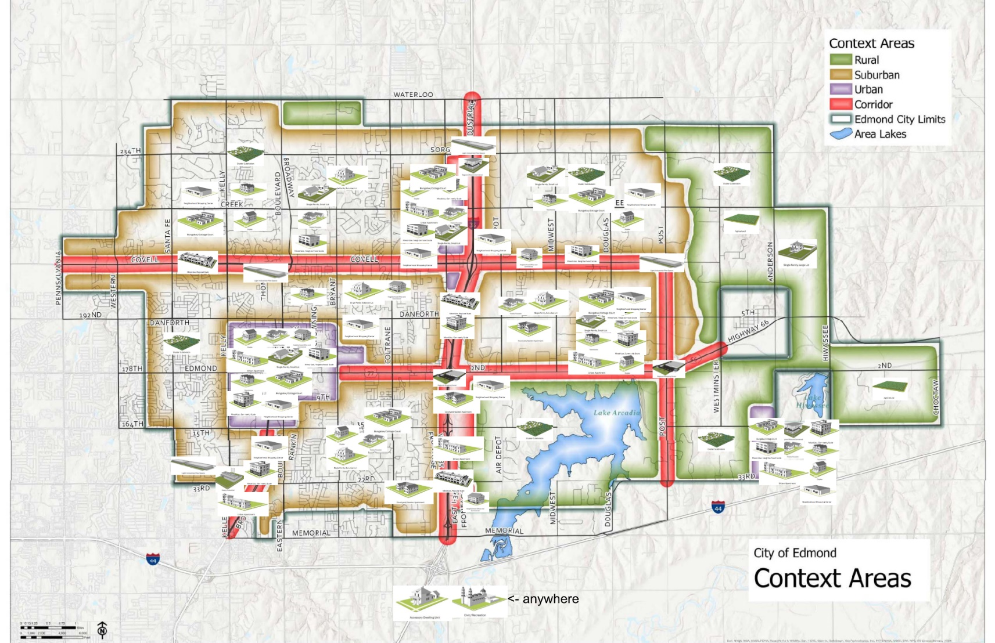
Building Types
Notes:
Don’t worry if you can’t tell what exactly is going on here- we’ll break it down… [explain that staff administered options from a menu of building types onto this map, etc.]

Slide 29
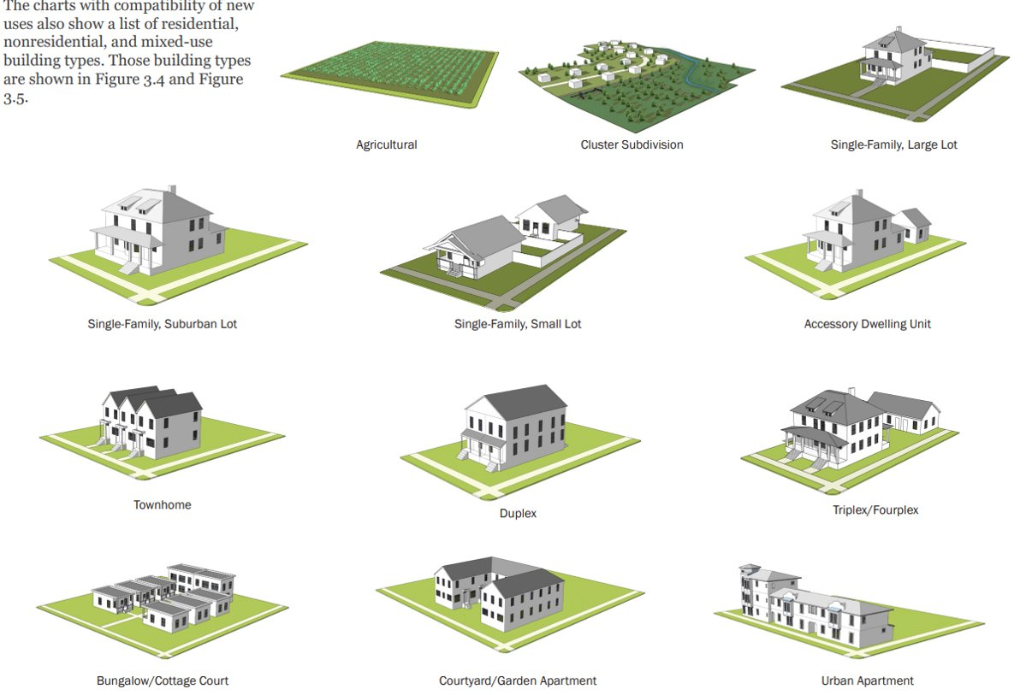
Building Types
Notes:
Here are some of those building types, specifically those oriented to residential uses

Slide 30
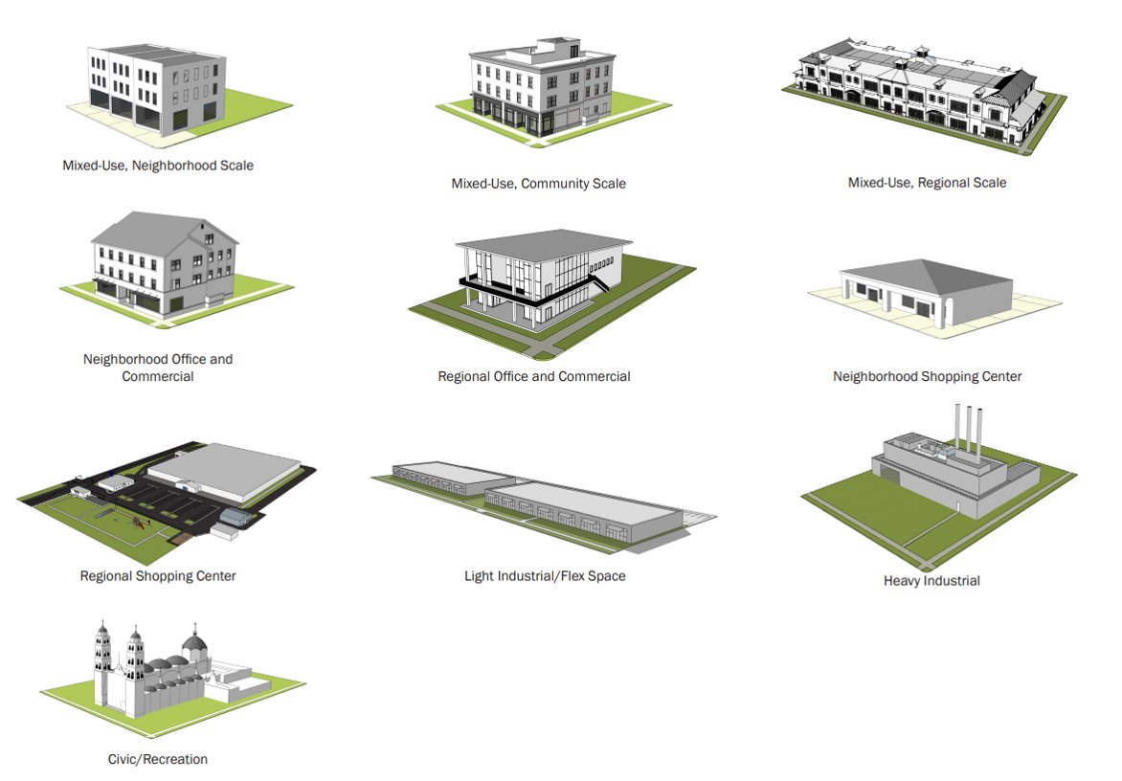
Building Types
Notes:
Here are the others, those which are mixed-use or non-residential

Slide 31
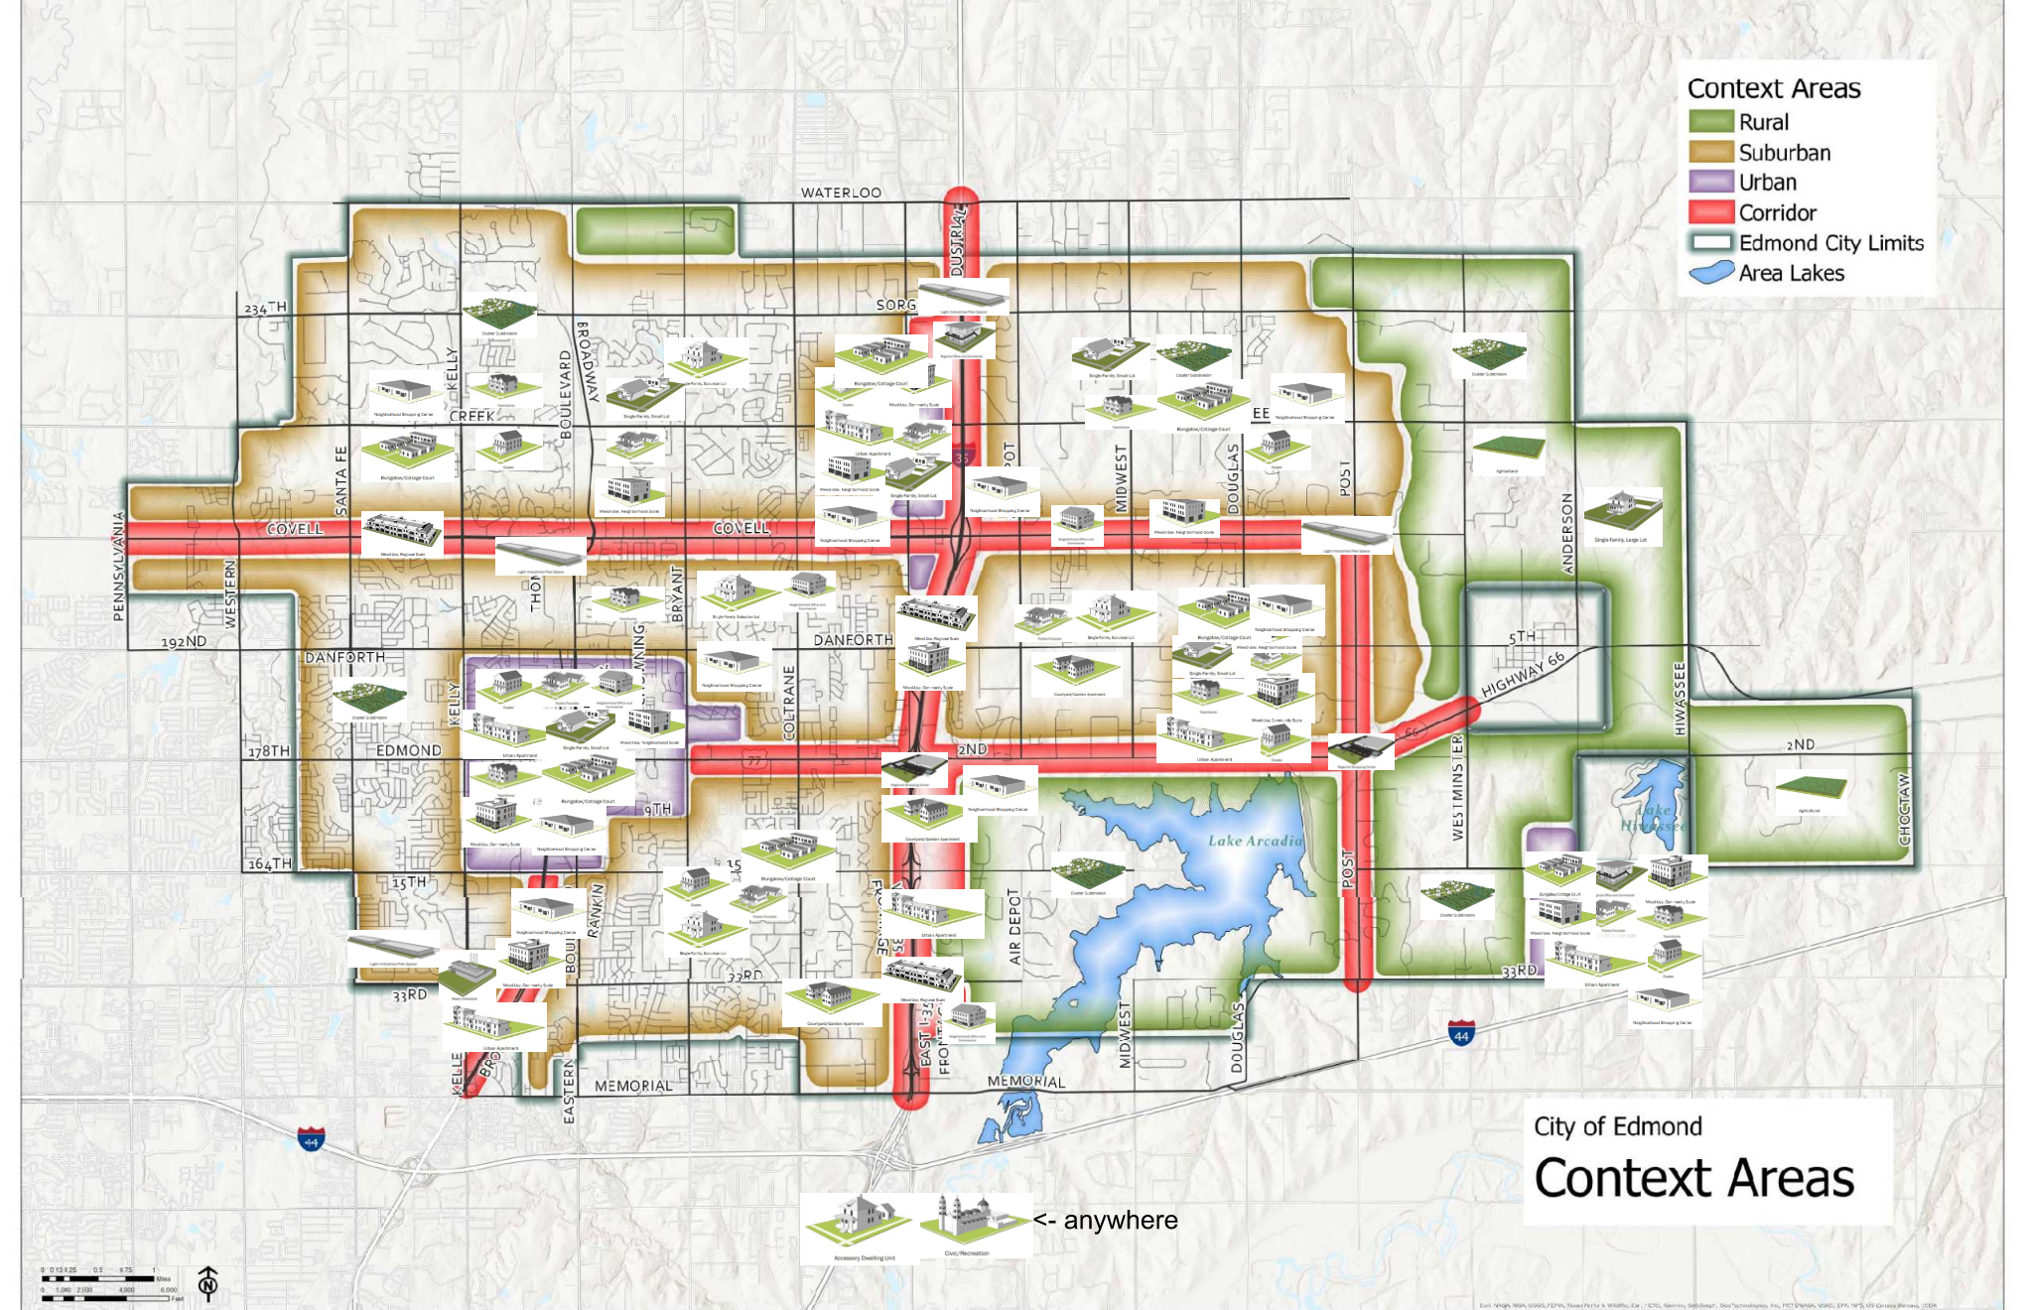
Building Types
Notes:
Again, don’t worry if you can’t parse everything, but this is what staff proposed for western Edmond

Slide 32
Building Types
Notes:
And for East Edmond…

Slide 33
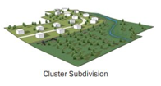
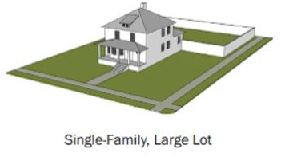
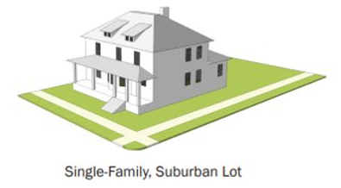
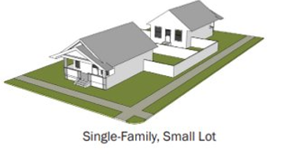
Building Type Matrix
 | Context | R |  | S
 | District | AP | MU | RE | MU | LC | RC | FI
Type | Graphic
Residential
Cluster Subdivision
Single-Family, Large Lot
Single-Family, Medium Lot
Single-Family, Small Lot
Notes:
There are different ways we can structure the Context Areas, and each method is well-suited to different ways of setting up and administering Zoning. Shown here, the approach we initially proposed, is a relationship which makes Context Areas highly regulatory, essentially another layer of Zoning. Each Context Area permits certain Districts, which generally cannot appear in other Context Areas.

Slide 34
In Other News
Legacy Districts
Limited application with new zoning map
Efficiently manage (post 2007) PUDs through the rezoning process
Dimensional Standards
Include purpose statement(s)
Adhere to and reference best practices
Special Regulations
Unique to a zoning district
To be used sparingly

Slide 35
In Other News
Specific Use Permits
Minimize use of this tool
Permitted use with additional conditions (special standards) where appropriate
Establish appropriate criteria for staff to apply administratively
Up next…
Development Standards

Slide 36
Building Type Matrix
Replace with new table/matrix image
Context Area | Residential Building Types | Non-residential Building Types
Rural | Cluster Subdivision Single-family Large-lot | Agricultural
Suburban | Cluster Subdivision Single-family Suburban-lot Single-family Small-lot Courtyard Apartment Duplex Triplex/Fourplex Cottage Court Townhome | Light Industrial Neighborhood Shopping Center Mixed-use Neighborhood Scale
Urban | Single-family Small-lot Townhome Cottage Court Duplex Triplex/Fourplex Urban Apartment | Neighborhood Shopping Center Mixed-use Neighborhood Scale Mixed-use Community Scale Regional Office and Commercial
Corridor | Courtyard Apartment Urban Apartment | Mixed-use Regional Scale Mixed-use Community Scale Neighborhood Office and Commercial Regional Shopping Center Regional Office and Commercial Light Industrial Heavy Industrial
Notes:
So, to really clarify everything and get granular with it, this matrix displays how the building types mapped by staff line up with the context areas; what should be allowed where, and from this you can gain an understanding of how we’re trying to steer built form and design.

