Slide 1



Advisory Committee Meeting
August 24, 2023

Slide 2
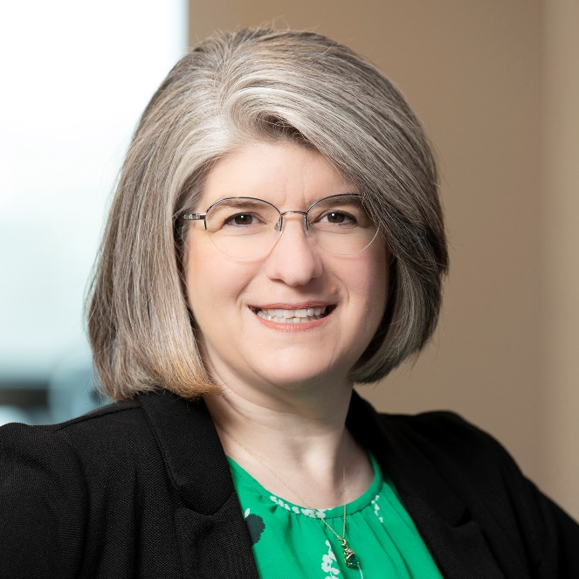
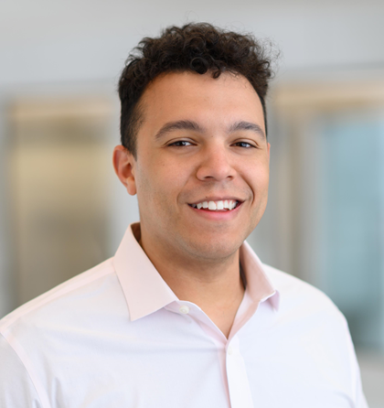
FNI TEAM
Dawn Warrick, AICP
Project Manager
Rhys Wilson
Project Planner

Slide 3
ADVISORY COMMITTEE
Patrick Altendorf
Jessica Bloye
Anthony Catania
David Chapman
Stephanie Coulter
Ryan Dawson
Jonathan Heusel
Mark Hoose
Dean Koleada
Scott Loper
Caleb McCaleb
Todd McKinnis
Josh Moore
Purvi Patel
Brandon Rader
Chip Winter
Mark Zitzow

Slide 4
GROUP AGREEMENTS
1
Listen for understanding
2
Be Open Minded
3
NO Judgement
4
Assume good intent
5
Give constructive feedback
6
Speak from your experience

Slide 5
ADVISORY COMMITTEE ROLES
Review and discuss draft elements of code
Share information and feedback
Serve as a sounding board for proposed changes
Provide local experience
Provide technical expertise where applicable

Slide 6
QUICK BREAK
August 24, 2023

Slide 7
PROJECT OVERVIEW
GOALS:
  Implement City’s planning policy direction
  Ensure new code generates orderly growth and reinvestment in established parts of Edmond
  Promote the community’s preferred development patterns

Slide 8
PROJECT SCHEDULE
PHASE | 1 | PHASE | 2 | PHASE | 3 | PHASE 4
Nov 2022 |  | Jul 2023 |  | Apr 2024 |  | Sep 2024 | Nov 2024
Phase 1
Diagnostic Report
Phase 2
Updated Development Codes
Phase 3
Mapping Updates
Phase 4
Adoption

Slide 9

COMMITTEE MEETINGS & TOPICS
8/24/23
Project Overview, Diagnostic Report
10/12/23
General Provisions, Zoning (Intro)
12/7/23
Zoning
1/11/24
Uses
3/21/24
Development Standards
5/9/24
Subdivision and Stormwater
6/13/24
Procedures

Slide 10
DIAGNOSTIC REPORT OVERVIEW
METHODOLOGY:
  Review existing development codes and administrative processes
  Understand the applicability of the City’s adopted long-range planning goals, policies, and action items
  Listen to stakeholders’ goals and experiences
  Document deficiencies in the development codes and processes
  Recommend alternative approach and code structure
  Review best practices
  Provide recommendations that reflect Edmond’s vision for the future

Slide 11



DIAGNOSTIC REPORT OVERVIEW
EXISTING PLANS REVIEWED:
Comprehensive Plan- Edmond Plan, 2018
2014 Edmond Downtown Master Plan
Downtown Design Guidelines
Edmond Downtown Area Parking Plan
EdmondShift
Parks and Recreation Master Plan

Slide 12
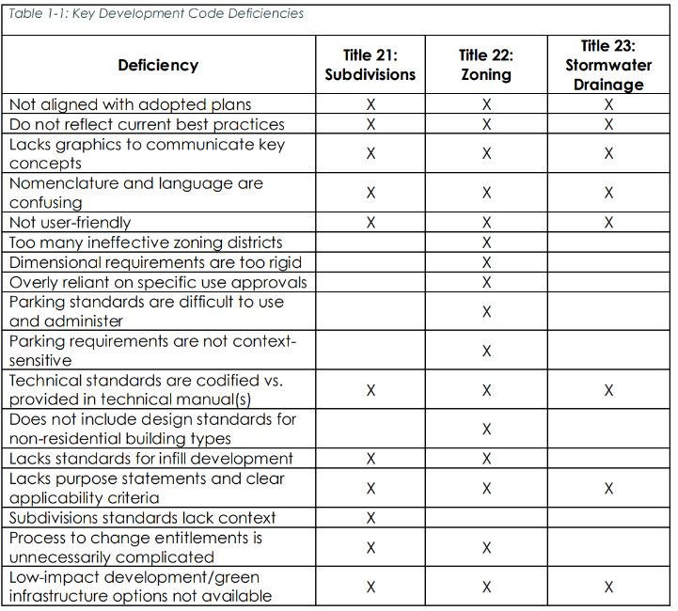
DIAGNOSTIC REPORT OVERVIEW
KEY DEVELOPMENT DEFICIENCIES IN CURRENT CODE

Slide 13
DIAGNOSTIC REPORT OVERVIEW
RECOMMENDATIONS:
  Encourage density where appropriate
  Relieve development pressure in scenic areas
  Include green infrastructure and low-impact development options
  Evaluate and update development review processes
  Provide clarity for property owners and developers
  Reorganize for easier navigability
  Add flow charts and graphics

Slide 14
WHAT IS A UNIFIED DEVELOPMENT CODE?
UDC
Zoning
Subdivisions
Quality
Development
Design Standards
Streamlined Processes
Signage

Slide 15


NEXT STEPS
Advisory Committee Meeting: OCTOBER 12, 2023
  Review draft General Provisions and discuss Zoning
Phase 2:
Draft Code Development
Phase 3:
Mapping Updates
July
2023
April
2024

