Slide 1


General Provisions Review &
Zoning Preview

Slide 2
General Provisions
Chapter | Section | Notes
24.01 – General Provisions | 24.01.010 – Title | Establishes how the UDC is referred
 | 24.01.020 – Purpose | Provides the UDC’s intent
 | 24.01.030 – Authority | Highlights the State Statutes that establishes the UDC
 | 24.01.040 – Applicability | A brief overview of where and how the UDC applies
 | 24.01.050 – Relationship to Other State, Federal, and Local Provisions | Clarifies which regulations control if there is conflict with the UDC and other regulations
 | 24.01.060 – Private Restrictions | States the UDC does not interfere with private restrictions
 | 24.01.070 – Severability | Disclaimer stating that if one part of the UDC is deemed legally invalid, that the entire UDC is not legally invalid
 | 24.01.080 – Repeal of Existing Ordinances | States the existing ordinances are to be repealed upon establishment of the UDC effective date
 | 24.01.090 – Effective Date | Establishes the date when UDC regulations apply

Slide 3
Questions about General Provisions?

Slide 4
Road Map
Zoning Types
Current Zoning
Future Land Use
Context Areas
Where We’re Headed
Next Steps

Slide 5
Zoning Types
Conventional
Form-Based
Composite
Hybrid

Slide 6
Conventional Zoning
Regulates development by separating different land uses and concentrating similar land uses into distinct areas or zones
Each zone has its own height, setback, parking, landscaping, and building volume restrictions that vary with intensity
Residential districts are usually located away from other intensified zoning districts
Development standards tend to be sparse because of the emphasis on use classification

Slide 7
Conventional Zoning
Advantages
Disadvantages
Familiarity
Effective at controlling development scale
Protects low-intensity uses from more intensive uses
Good for auto-centric communities
Not much emphasis on development design
Segregates uses (exclusionary)
Outdated dimensional and development regulations
Not much ability for unique or mixed-use development
Unpredictable

Slide 8
Form-Based Zoning
Regulates development by focusing on the scale, design, and placement of buildings
Particular attention is given to development’s relationship with the street and other public spaces
Belief that the look and arrangement of buildings better define a community’s character than the actual uses that take place within those buildings
Typically includes a regulating plan that establishes the boundaries where Form-Based Zoning applies
Good approach if the goal is to increase site attractiveness, maintain community character, maximize use diversity, and promote walkable/pedestrian-friendly style developments

Slide 9
Form-Based Zoning
Advantage(s)
Disadvantage(s)
Addresses site design
Outcome specific
More use allowances = more landowner flexibility
Good for dense or walkable areas
Community compatibility
Not much familiarity
Complicated and layered regulations
Limited scope
Not too popular with developers
Less public input

Slide 10
Composite Zoning
A customizable approach that utilizes three development components – use, form, and site - to create a variety of zoning districts
Use – establishes the types of land uses (residential, commercial, industrial, etc.) permitted within a zoning district and relates them to form
Form – height limits, entryway typologies, façade design standards, etc. classified to the permitted use.
Site – The arrangement of the site, building location, landscaping, parking, and accessibility are addressed after use and form are established

Slide 11
Composite Zoning
Advantages
Disadvantages
Addresses site design
More flexibility
Customizable menu and limitless options
Context sensitive
Land use mix
Reduction in zoning districts
Not much familiarity
Complicated and layered regulations

Slide 12
Hybrid Zoning
Incorporates the best practices from the various zoning approaches – conventional, form-based, performance-based, composite - to create appropriate zoning regulations
Typically, hybrid zoning has a base layer like a conventional zoning approach with additional regulations noticed in form-based and performance-based zoning codes
It’s a context-sensitive approach that requires different regulations for certain areas within a city

Slide 13
Hybrid Zoning
Advantages
Disadvantages
Innovative
Comprehensive
Effective balance of flexibility and certainty
Customizable menu
Mix of conventional and modern techniques
Not much familiarity
Complicated and layered regulations

Slide 14
Areas of consideration for specific zoning approaches
Zoning Type → Area ↓ | Conventional | Form-Based | Composite
Downtown | ○○○ | ●●● | ●○○
Lake Area | ●○○ | ●●● | ●●○
Corridors | ●●○ | ●●○ | ●●○
Rural Edmond | ●●○ | ○○○ | ●○○
Suburban (established) Edmond | ●●● | ○○○ | ●●○
Key | ○○○ = Not Appropriate ●○○ = Somewhat Appropriate ●●○ = Appropriate ●●● = Most Appropriate

Slide 15
Current Zoning Approach
Conventional zoning with districts focused on regulating uses
Not much consideration for context-sensitive zoning regulations aside from overlay treatment
Creates segregated land use pattern where the car is the primary mode of transportation
Protects agricultural and residential property rights effectively
Not much opportunity to integrate housing variety
Minimal distinctions between zoning district purposes

Slide 16
Current Zoning Approach
Conventional, use-based
Context-sensitivity via overlays ◄
Autocentric
Protects property rights ◄
Limits housing variety
Redundance in district purposes ◄

Slide 17
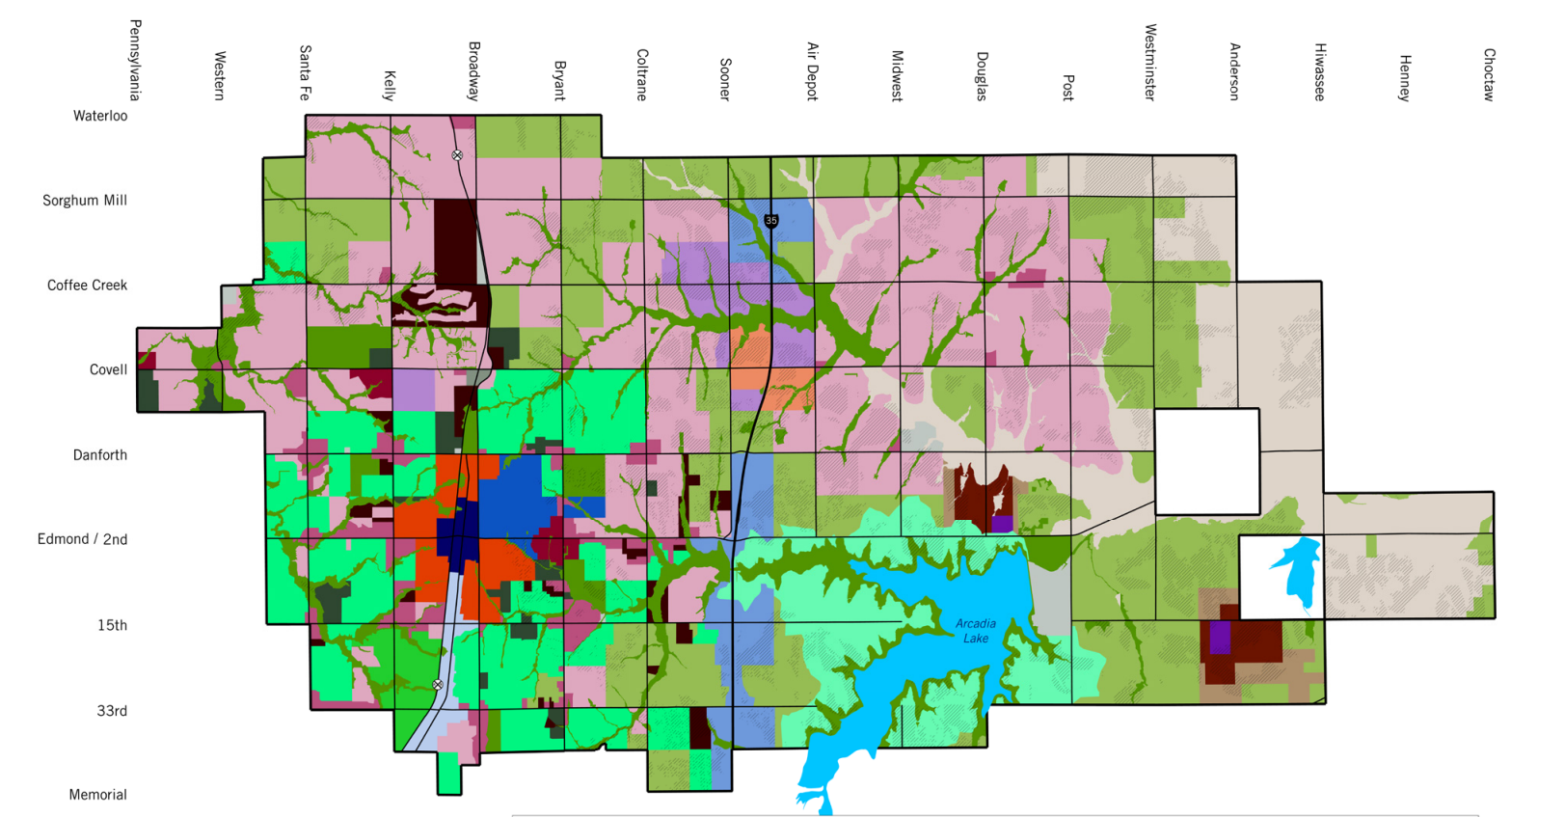
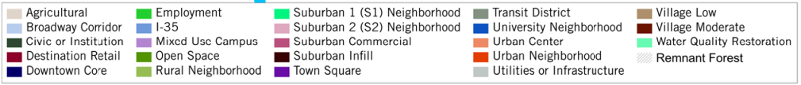
Future Land Use

Slide 18
Context Areas

Slide 19
Downtown
Brainstorming Questions
What should our boundaries be?
What types of design elements do we want to regulate?
What types of buildings/ developments do we want to see?
How tall do we want to go?
What kinds of building materials do we need to encourage or prevent?
Downtown Highlights (Master Plan & Comp Plan)
Vibrancy required
Walkable area to live-work-play
Pedestrian-scaled development
Encourage multi-story mixed-use development
Promote small-scaled public spaces
Preserve form
Right-size parking
Development flexibility needed
Clear processes

Slide 20
Lake Area
Brainstorming Questions
What types of design elements do we want to regulate?
What types of development do we want to see?
How tall do we want to go?
What kinds of residential units should be allowed?
What infrastructure items should be required for development?
Comp Plan Highlights
Protect forestry
Establish town square/village development
More mixed-use & less single-use development
Explore density bonuses
Provide adequate infrastructure that supports development

Slide 21
Corridors
Brainstorming Questions
What types of development do we want to see?
What uses are problematic? Should those uses be limited?
What kind of redevelopment tools would be preferred?
Comp Plan Highlights
Attract visitors and employers from across the region
Serve as gateways to Edmond
Feature high intensity activity
High sales tax developments
Vertical development warranted
Promote infill development
Continue rehabilitating and renovating existing developments
More mixed-use development
Convert large surface parking areas into higher intensity development
Incorporate more public spaces

Slide 22
Where We’re Headed
Establish Context Areas
Propose Districts within each Context
Create well-crafted purpose statements reflective of the Comp Plan
Establish Building Typologies that correspond with each District
Provide a Zoning Equivalency Table or establish Legacy Districts

Slide 23

Next Steps
Zoning Districts Chapter Draft
Current Zoning
Future Land Use
Context Areas
Zoning Districts
Building Typologies
District Dimensional Standards
Zoning Districts Chapter Draft
Current Zoning
Future Land Use
Context Areas
Zoning Districts
Building Typologies
District Dimensional Standards

Slide 24
Discussion

